Slide 1

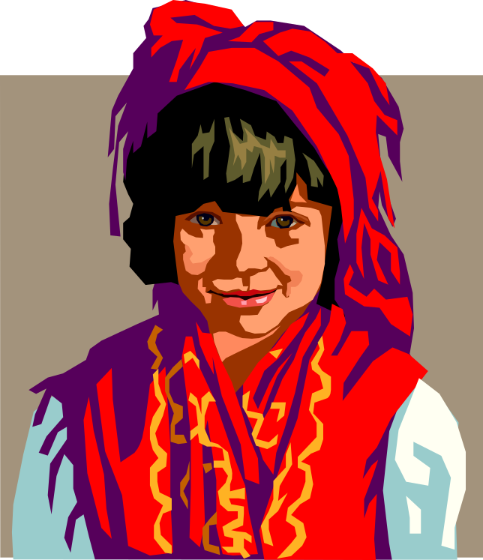
The Nature of
Organization and Social Culture
Organization culture: the set of values, beliefs, behaviors, customs, and attitudes that help the members of the organization understand what it stands for, how it does things, and what it considers important.
Multiculturalism: the broad issues associated with differences in values, beliefs, behaviors, customs, and attitudes held by people in different cultures.

Slide 2
Diversity and Multiculturalism in Organizations
All organizations are becoming more diverse and multicultural.
The reasons for increasing diversity and multiculturalism
  Legislation: diversity improves the quality of the workforce, changing demographics, the globalization movement.

Slide 3

Dimensions of Diversity and Multiculturalism
Age distributions: average age of the workforce is increasing, median age is expected to rise from 35.5 to 38 years.
Gender: more women are entering the workforce causing organizations to change the relative proportion women to men, to create a fair balance.

Slide 4
Reasons for Increasing
Diversity and Multiculturalism
Legislation and
legal action
Changing
demographics in
the labor force
Increasing diversity and multiculturalism in organizations
Increased awareness
that diversity
improves the
quality of the
workforce
The globalization
movement

Slide 5

The Glass Ceiling
A barrier that keeps women from advancing to top management positions in many organizations.
This ceiling is a real barrier that is difficult to break, but is also subtle that is difficult to discern.

Slide 6
Ethnicity
The third major dimension of cultural diversity in organizations is ethnicity.
Ethnicity refers to the ethnic composition of a group or organization.
The biggest projected changes involve whites and Hispanics, the percentage of whites in the workforce is expected to drop from 72% to 62.4%.
Hispanics will climb from 11.5% to 17.6%, while other groups will rise at a lower rate.

Slide 7
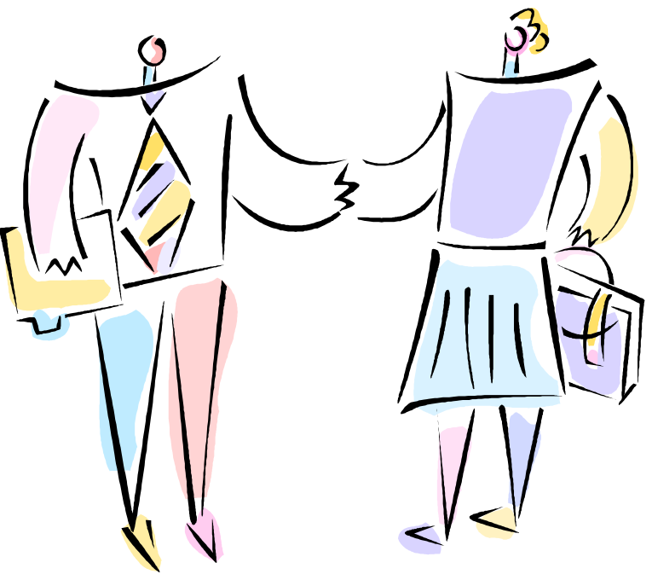
Effects of Diversity and
Multiculturalism in Organizations
Diversity, multiculturalism, and competitive advantage, for example:
  Organizations that learn to manage diversity and multiculturalism generally have higher levels of productivity and lower levels of turnover and absenteeism.
Conflict can rise through misunderstood, misinterpreted, or inappropriate interactions between people of different groups.
However, these conflicts will disappear in the future.

Slide 8

Managing Diversity and
Multiculturalism in Organizations
Understanding is an important element of managing diversity and multiculturalism.
Empathy: people in organizations should try to understand the perspective of others.
Tolerance: learning to accept all aspects of another person’s beliefs or behavior.
Willingness to communicate: initiate two-way communication between people.

Slide 9
Organizational Approaches
Organizational policies that an organization adopts to affect directly and indirectly how people are treated.
Organizational practices through benefits packages and flexible work hours.
In addition, making sure that all committees and executive teams are diverse.

Slide 10

Toward the Multicultural Organization
An organization that has achieved high levels of diversity is able to capitalize fully on the advantages of diversity and has few diversity-related problems.
Few, if any organizations have become truly multicultural.
More and more organizations are moving in this direction.

Slide 11
How Diversity and Multiculturalism Promote Competitive Advantage
Resource
Acquisition
argument
Cost
argument
Creativity
argument
Competitive
Advantage
Marketing
argument
Systems
Flexibility
argument
Problem-
Solving
argument

